Slide 1


Design of Autonomous Vehicle Driving , Tracking and Monitoring
Ministry of Higher Education
Pyramids High Institute (PHI) for Engineering and Technology
Electronics and Communication Engineering Department
Under Supervision
Dr. Gamal Elshiekh
Dr. Esraa Elrefaey
Team Members
Abdelrahman Shrief
Asmaa Mohamed
Sondos Reda
Mohammed Hossam
Mohammed Alaa
Mohammed Nageh
Mahmoud Gaballah
Moamen Mourad

Slide 2
Outlines
Introduction about project idea
Applying GPS theory on the project
Connecting the project with users via GSM Solutions
Making a video streaming in a web application
Applying face detection and recognition for drivers
Make a connection between users and the device via Web App
Implement a backup plan for network connection failing
Testing the project idea on a self-driving car
Apply the project idea and test it for real vehicles
Conclusion & future work

Slide 3
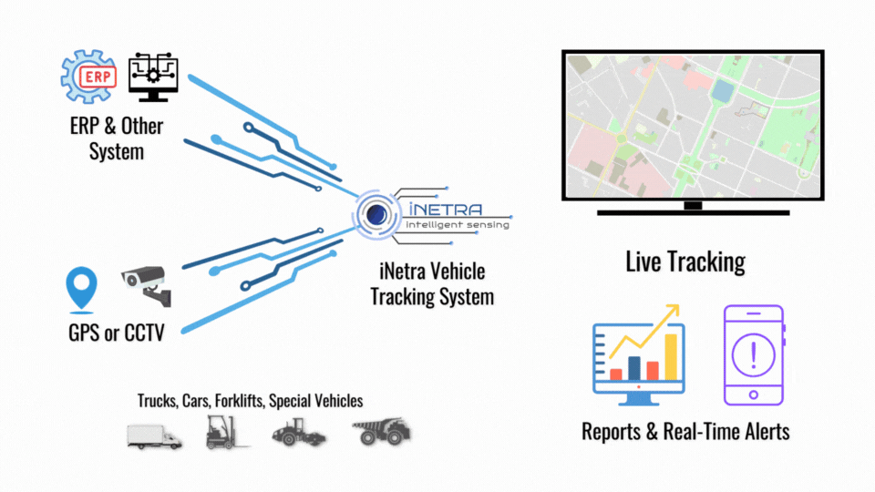
Project Layout
Rpi 4 Model B
Main MCU
GPS Technology
GSM
Connectivity
Web Application
Security Schema
Testing with
Self-Driving Car
Testing with
Real Vehicles
SIM808
SIM808
Driver Face
HTML
PHP
Rpi cam V1.3
Css

Slide 4
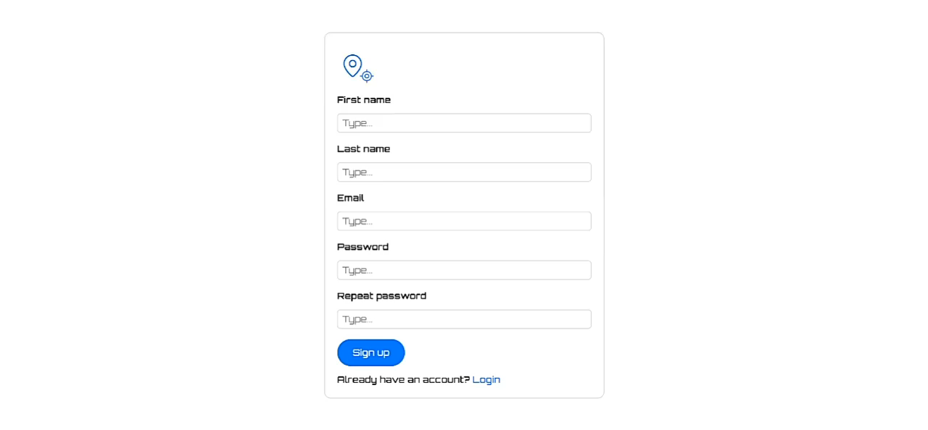
Web Application Design

Slide 5
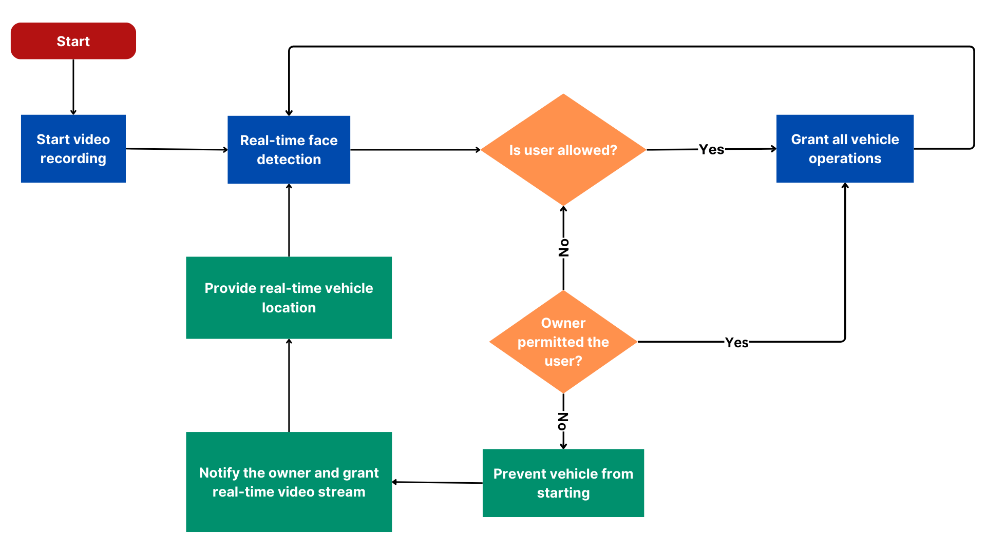
Project Security Schema

Slide 6
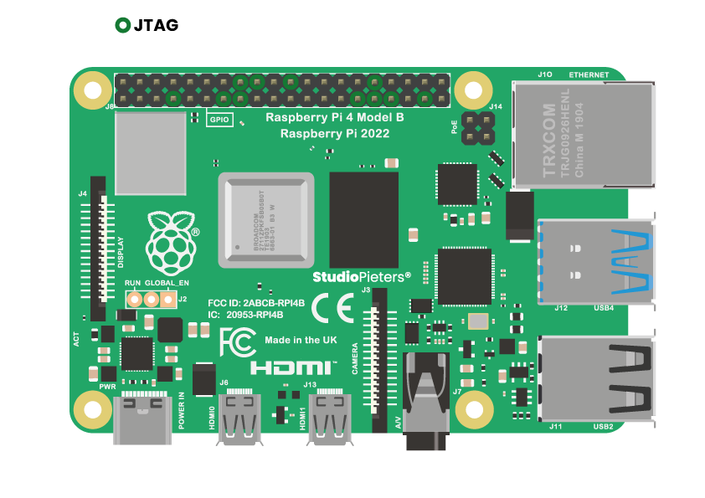

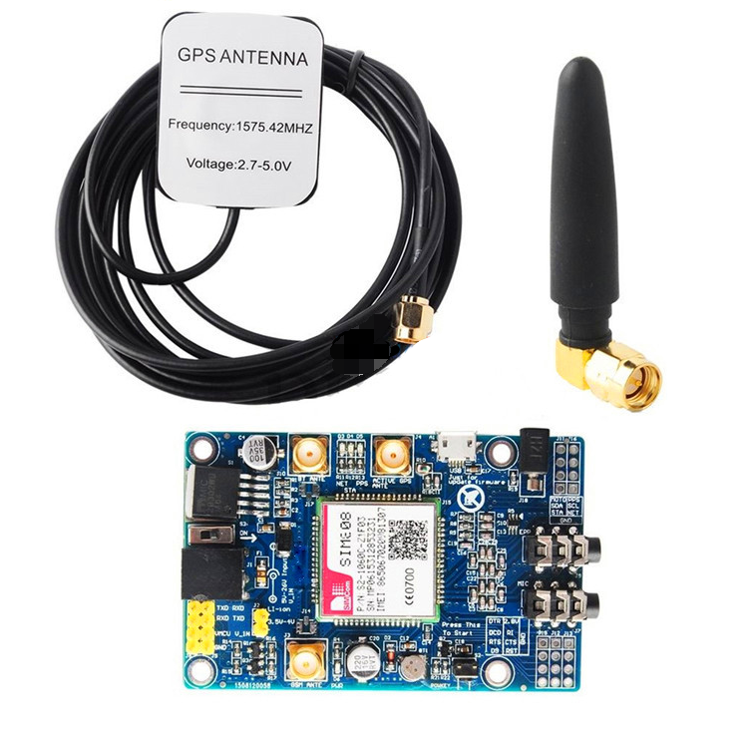
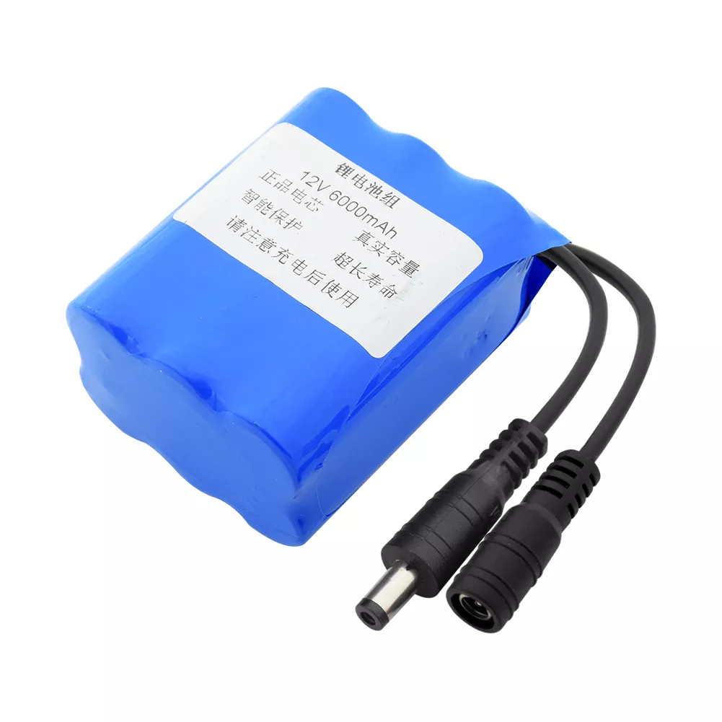
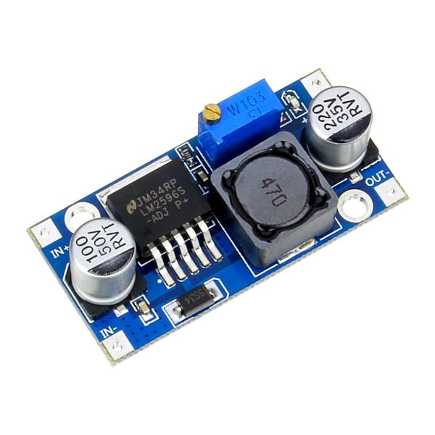
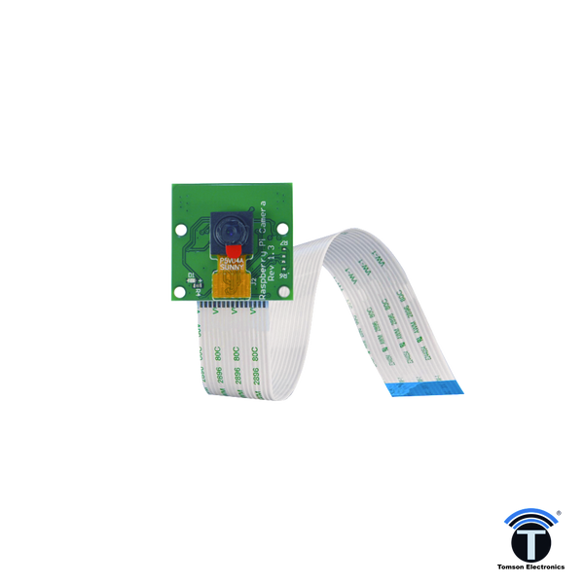
Hardware Block Digram
GSM + GPS Module
Main Controller
Server
DC-DC Converter
Battery
Camera
Conclusion

Slide 7
Raspberry pi 4 model B
Specifications
Broadcom BCM2711, Quad core Cortex-A72 (ARM v8) 64-bit SoC @ 1.8GHz
2.4 GHz and 5.0 GHz IEEE 802.11ac wireless, Bluetooth 5.0, BLE
2 USB 3.0 ports; 2 USB 2.0 ports.
Raspberry Pi standard 40 pin GPIO header
2 × micro-HDMI® ports (up to 4kp60 supported)
2-lane MIPI CSI camera port
Micro-SD card slot for loading O.S and data storage
5V DC via USB-C connector (minimum 3A*)
Usage and main functions
Manage H.W Components
Works As Local Server
Resbonsable for Face Recognition
Back

Slide 8
GSM + GPS Module SIM808
Specifications
Controlled by AT Command
Voltage Input : 5 - 20 V
Quad-band 850/900/1800/1900 MHZ
Supports 3.0V to 5.0V logic level
Low power consumption, 10mA in sleep mode
Supports GPS Technology and LED status indicators
SIM card holder
PCB size: 53mm X 48mmX1.6mm
Usage and main functions
GSM
Receive and Send SMS and Calls
Works As Backup Connection
Alert the Admin If GPS or Wifi not Working
GPS
Heart of The Project
Provide Location Data To Admin
Can Be Used to Determine Car Speed
Back

Slide 9
Camera
Specifications
Fully Compatible with Both the Model A and Model B Raspberry Pi
5MP Omnivision 5647 Camera Module
Still Picture Resolution: 2592 x 1944
Video: Supports 1080p @ 30fps, 720p @ 60fps and 640x480p 60/90 Recording
15-pin MIPI Camera Serial Interface - Plugs Directly into the Raspberry Pi Board
Size: 20 x 25 x 9mm
Weight 3g
Fully Compatible with many Raspberry Pi cases
Usage and main functions
Take Photos for The Driver
Can be used for Training Ai Model
Capture Videos For Un-Auth Drivers
Back

Slide 10
Battery
Specifications
Nominal voltage: 12v
Input voltage: 12.6V
Output voltage: 8V to 12.6V
Battery capacity: 120000mah (12Ah), deviation ±5%,
Size: 56*60*66 mm , deviation ±5mm
Packing: Blue PVC
With protection circuit: have overcharge, over discharge, over current
Usage and main functions
Manage H.W Component’s Power
Has a Rechargeable Circuit
Reliable for Working Many Hours
Back

Slide 11
DC-DC Converter
Specifications
Rated Output Current: 2A
maximum load current can reach 3A with an additional heatsink
Efficiency: Up to 92%
Operating Temperature Range: -40°C to +85°C at output power of 10W or less
Switching Frequency: 150kHz
Input voltage: from 3 V to 40 V
Adjustable output voltage: from 1.5 V to 35 V
Usage and main functions
convert a higher DC voltage to a lower DC voltage
has a good efficiency.
Back

Slide 12
GSM + GPS Module SIM808
Functions
Send AT commands
Parses sms
Read sms
Send sms
Make call
Hang up
Check network
http get
http post
Check sim status
Get battery status

Slide 13
Send AT commands :
Sends an AT command to the SIM808 module and reads the response.
Function send_at_command(serial_object, command, delay)
Write command to serial connection
Sleep for delay
Read and decode response
Return response
End Function

Slide 14
Parses sms :
Parses the SMS response to extract the sender's number and message content.
Function parse_sms(response)
Define regex pattern for sender and message
Find matches in response
Clean message content
Return list of (number, message) tuples
End Function

Slide 15
Get battery status
Gets the battery status of the SIM808 module.
Function get_battery_status(serial_object)
Send battery status command
Return response
End Function

Slide 16
Read sms :
Reads the list of SMS messages stored in the SIM808 module.
Send sms :
Makes a voice call to the specified number.
Function read_sms(serial_object)
Send command to set SMS mode to text
Send command to list unread messages
Parse response to extract messages
Return list of messages
End Function
Function send_sms(serial_object, number, message)
Send command to set SMS mode to text
Send command with recipient's number
Write message content and control character
Sleep for delay
Read and return response
End Function

Slide 17
Make call :
Makes a voice call to the specified number.
Hang up :
Hangs up the current call.
Function make_call(serial_object, number)
Send dial command
Return response
End Function
Function hang_up(serial_object)
Send hang up command
Return response
End Function

Slide 18
Check network :
Checks the network registration status.
Check sim status :
Checks the status of the SIM card.
Function check_network(serial_object)
Send network status command
Return response
End Function
Function check_sim_status(serial_object)
Send SIM status command
Return response
End Function

Slide 19
Http get :
Performs an HTTP GET request to the specified URL.
Http post :
Performs an HTTP POST request to the specified URL with the given data.
Function http_get(serial_object, url)
Send initialize HTTP command
Set context ID and URL
Send HTTP GET request
Terminate HTTP service
Return response
End Function
Function http_post(serial_object, url, data)
Send initialize HTTP command
Set context ID, URL, and content type
Prepare to send data
Sleep for delay
Write data
Send HTTP POST request
Terminate HTTP service
Return response
End Function

Slide 20
Live stream
Functions
Generate frames
Video feed

Slide 21
Generate frames:
Captures frames from the camera and encodes them as JPEG.
Video feed:
Route to stream video from the camera.
Function generate_frames()
While True
Capture frame from camera
Convert frame to JPEG format
Encode frame to bytes
Yield frame in byte format for streaming
End Function
Function http_post(serial_object, url, data)
Send initialize HTTP command
Set context ID, URL, and content type
Prepare to send data
Sleep for delay
Write data
Send HTTP POST request
Terminate HTTP service
Return response
End Function

Slide 22
Camera module
Functions
Test camera connection
Capture image
Record video

Slide 23
Test camera connection :
ests if the camera is connected and can capture an image
Capture image :
Captures an image using the camera.
Function test_camera_connection() -> str
Try
Define photo_path with current timestamp
Run rpicam-still command to capture image
Return photo_path
Catch exception
Return 'null'
End Function
Function capture_image() -> str
Define photo_path with current timestamp
Run rpicam-still command to capture image
Return photo_path
End Function

Slide 24
Record video :
Records a video for a specified duration.
Function record_video(sec : int = 5) -> str
Define video_path with current timestamp
Run rpicam-vid command to record video for given duration
Return video_path
End Function

Slide 25

Self-Driving Car Idea
Control a car across web site via the ESP8266 and Arduino Uno Throughout the MPU6050 readings

Slide 26
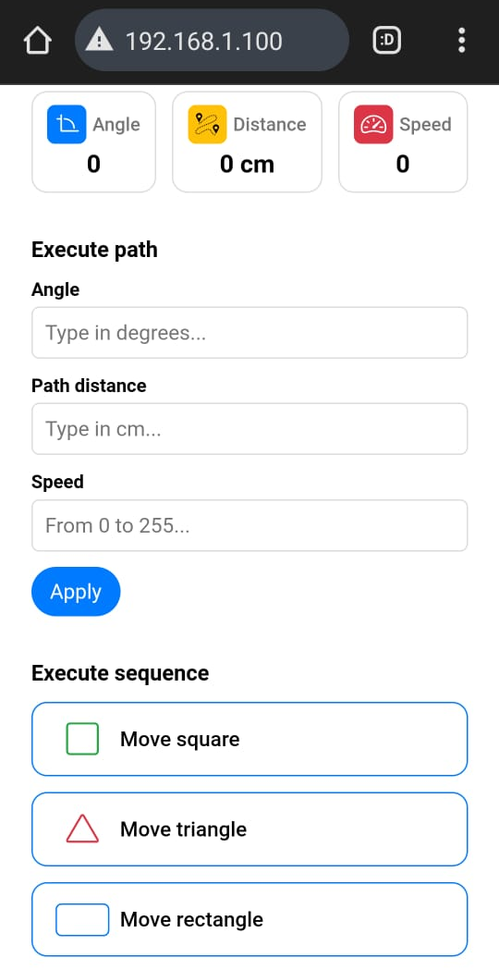



Slide 29
The connection between the web site & the car
for controlling an autonomous car via an ESP8266 microcontroller. The system allows users to remotely control the car and view real-time data on its movements and actions by connecting to the ESP network which called Autonomous Car and password is auto2244 ,then can go to 192.168.1.100 which operates as the Server Side.

Slide 30
Present the car

Slide 31

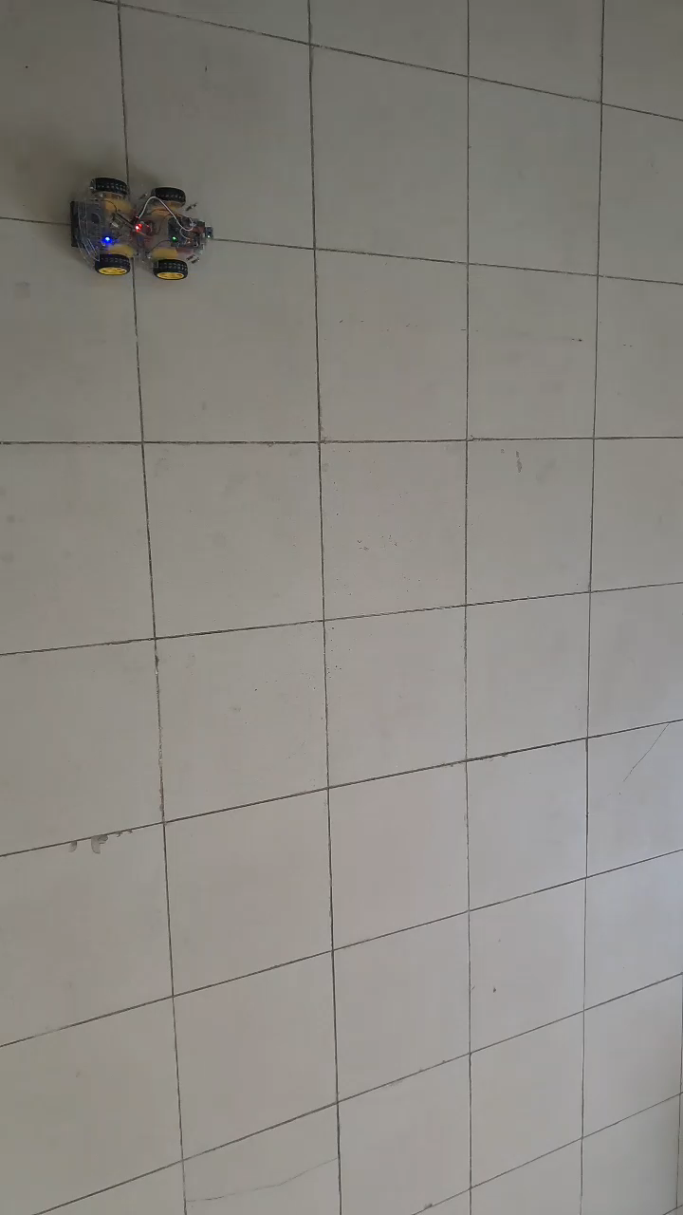

Slide 32
Outlines
Functions’ Algorithms
Mpu6050 Angles Calculations
Movements of the car
Execute Sequence
Execute Path
Go To (x,y) Coordinates
Distance Calculations

Slide 33
Mpu6050 Angles Calculations
Calculate the error:
Purpose: Calibrates the IMU sensors to reduce error in readings.
Benefits: Improves the accuracy of sensor data, enhancing navigation performance.
2. Update readings:
Purpose: Obtains and updates the latest readings from the MPU.
Benefits: Ensures the robot has the most current sensor data for decision-making.
function calculate_IMU_error():
for i from 0 to 200
read sensor data
accumulate errors
average errors to reduce drift
function update_mpu_readings():
initiate I2C transmission with MPU
request data
read accelerometer and gyroscope values

Slide 34
Movements of the car
Purpose: Activates motors to move the robot forward or left or right
Benefits: Provides basic forward, left , right movement functionality.
function instantStop():
set motorR1 HIGH
set motorR2 HIGH
set motorL1 HIGH
set motorL2 HIGH
function moveForward()
set motorR1 LOW
set motorR2 HIGH
set motorL1 LOW
set motorL2 HIGH
function moveRight():
set motorR1 HIGH
set motorR2 LOW
set motorL1 LOW
set motorL2 HIGH
function moveLeft():
set motorR1 LOW
set motorR2 HIGH
set motorL1 HIGH
set motorL2 LOW

Slide 35
Execute path
Purpose: Calculates and executes the path based on the initial angle and distance.
Benefits: Enables precise navigation by adjusting the robot's movements based on sensor feedback.
function SetCarPath(initial_angle,path_distance, speed):
turnCar(initial_angle)
moveForward()
while distance < path_distance:
adjust motor speeds based on sensor feedback
if obstacle detected
stop and recalculate path

Slide 36
Execute Sequence
Purpose: Moves the robot in a square pattern.
Benefits: Demonstrates the robot's ability to execute complex shapes.
function moveSquare(length, speed):
for i from 1 to 4:
SetCarPath(yaw, length, speed)
turnCar(yaw - 90, speedTurn)
Purpose: Moves the robot in a triangular pattern.
Benefits: Shows versatility in movement patterns.
function moveTriangle(length, speed):
for i from 1 to 3:
SetCarPath(yaw, length, speed)
turnCar(yaw - 120, speedTurn)
Purpose: Moves the robot in a rectangular pattern.
Benefits: Further demonstrates the robot's capability to perform complex movements.
function moveRectangle(length, width, speed):
SetCarPath(yaw, length, speed)
SetCarPath(yaw - 90, width, speed)
SetCarPath(yaw, length, speed)
SetCarPath(yaw - 90, width, speed)

Slide 37
Execute Sequence
Purpose: Executes predefined movement sequences based on the input string.
Benefits: Simplifies complex movements into manageable commands for the robot.
function performSequence(str):
if str == "moveSquare":
moveSquare(squareLength, squareSpeed)
if str == "moveRectangle":
moveRectangle(rectangleLength, rectangleWidth, rectangleSpeed)
if str == "moveTriangle":
moveTriangle(triangleLength, triangleSpeed)

Slide 38
Go To (x,y) Coordinates
Purpose: move a vehicle to a specified location (XD, YD) with a given speed. It calculates the necessary angle and distance, sets the car's path, and turns the car back to its initial angle after moving to the destination.
Benefits:
function moveToLocation(XD, YD, speed)
Init_Angle = yaw
if XD == 0 and YD == 0
return
if XD == 0 and YD > 0
SetCarPath(0, abs(YD), speed)
turnCar(Init_Angle, speedTurn)
return
if XD == 0 and YD < 0
SetCarPath(180, abs(YD), speed)
turnCar(Init_Angle, speedTurn)
return
if XD > 0 and YD == 0
SetCarPath(-90, abs(XD), speed)
turnCar(Init_Angle, speedTurn)
return
if XD < 0 and YD == 0
SetCarPath(90, abs(XD), speed)
turnCar(Init_Angle, speedTurn)
return
angle = atan2(XD, YD) * 180 / PI
diameter_squared = abs(XD) * abs(XD) + abs(YD) * abs(YD)
diameter = sqrt(diameter_squared)
SetCarPath(-angle, diameter, speed)
turnCar(Init_Angle, speedTurn)

Slide 39
Prototype Update Review for ( 50 , 50)
0
1
2
3
4
5
6
7
8
9
0
1
2
3
4
5
6
7
8
9
Y-axis
(
,
)
0
1
2
3
4
5
6
7
8
9
0
1
2
3
4
5
6
7
8
9
0
1
2
3
4
5
6
7
8
9
0
1
2
3
4
5
6
7
8
9
0
1
2
3
4
5
6
7
8
9
0
1
2
3
4
5
6
7
8
9
0
1
2
3
4
5
6
7
8
9
0
1
2
3
4
5
6
7
8
9
X-axis

Slide 40
Conclusion

Slide 41
Thank You

